Slide 1
Competitive Programming
06 Jan. 2023
Andrei Novikov

Slide 2
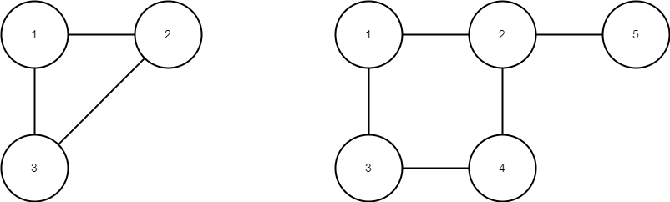
Practice – Challenge #1
Resource: LeetCode
0684 Redundant Connection – Link to the Task.

Slide 3
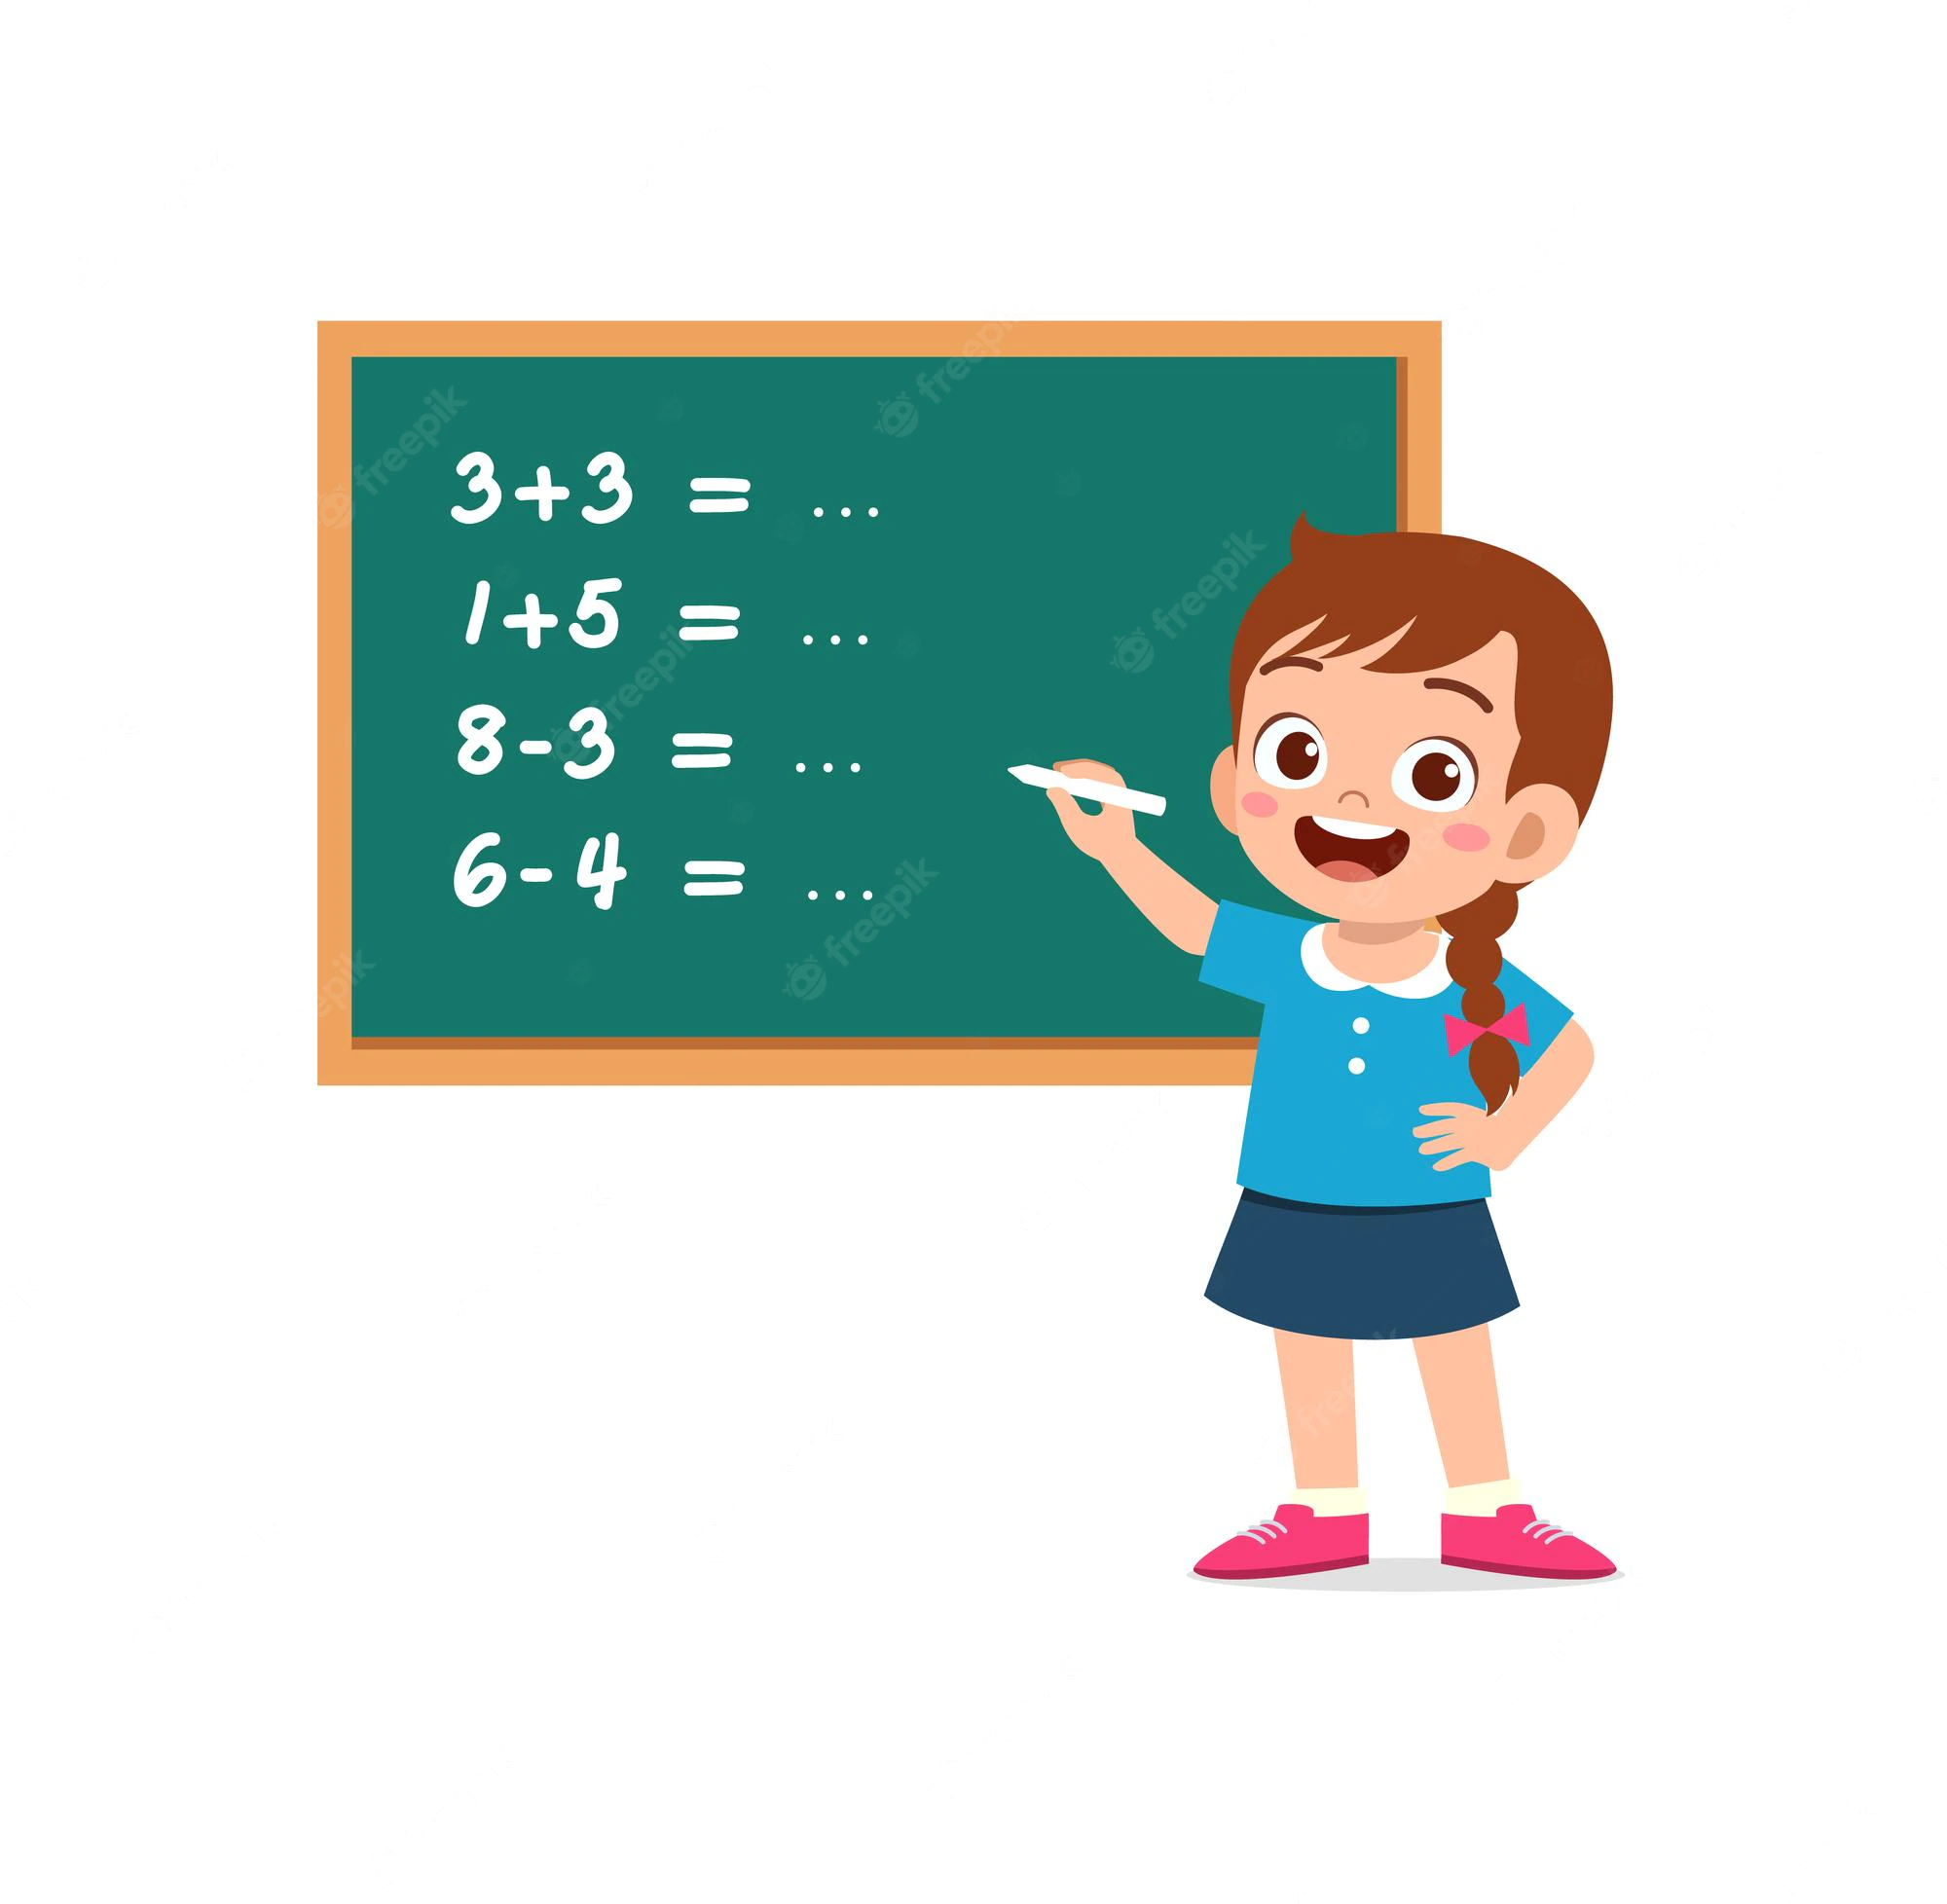
Practice – Challenge #1 – Think
Read the task (link) and think about possible solution.

Slide 4
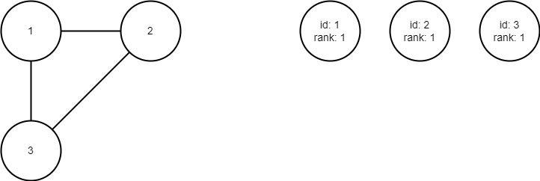
Practice – Challenge #1 - Approach
Disjoint Sets
Graph

Slide 5
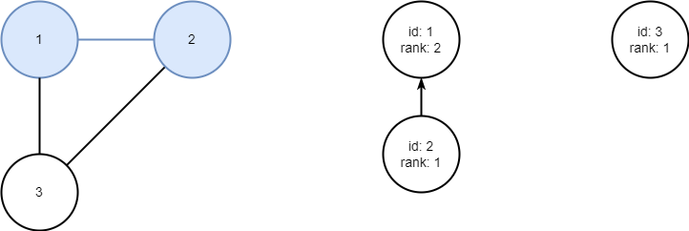
Practice – Challenge #1 - Approach
Merge nodes from edge [1, 2]

Slide 6
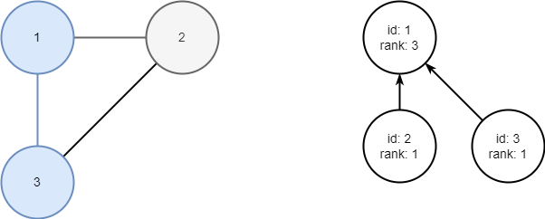
Practice – Challenge #1 - Approach
Merge nodes from edge [1, 3]

Slide 7
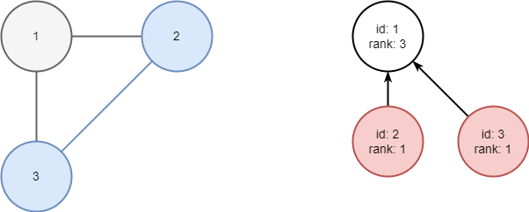
Practice – Challenge #1 - Approach
Nodes 2 and 3 already in the same set! The edge is redundant.

Slide 8
Practice – Challenge #1 – Think
Implement the solution for the task.

Slide 9
Practice – Challenge #1
Resource: LeetCode
0684 Redundant Connection – Link to the Task.
Solution: Disjoint Sets to detect the redundant edge almost like in MST.
Solution – Link.

Slide 10
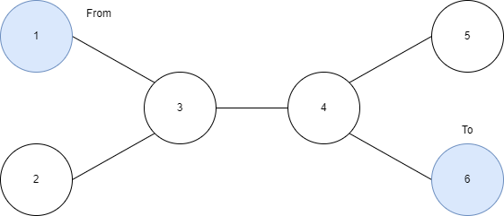
Practice – Challenge #2
Resource: LeetCode
1971 Find if Path Exists in Graph – Link to the Task.

Slide 11
Practice – Challenge #2 – Solve
Read the task (link) and think about possible solution.

Slide 12
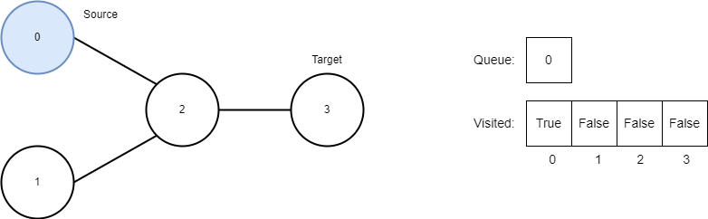
Practice – Challenge #2 - Approach
BFS Example
Graph
Initial State

Slide 13
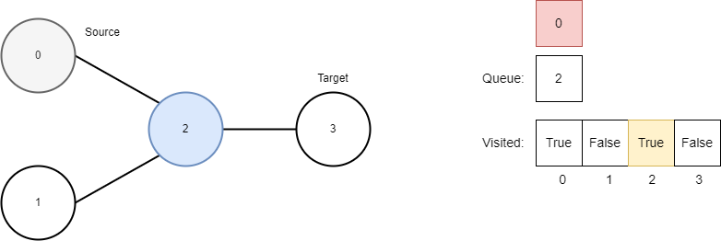
Practice – Challenge #2 - Approach

Slide 14
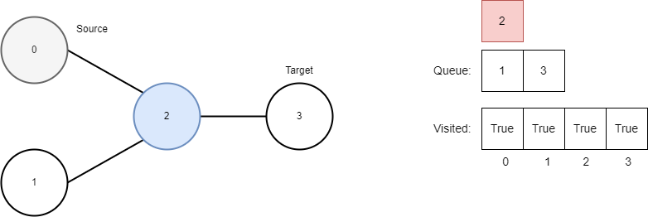
Practice – Challenge #2 - Approach

Slide 15
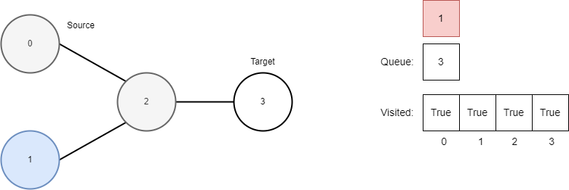
Practice – Challenge #2 - Approach

Slide 16
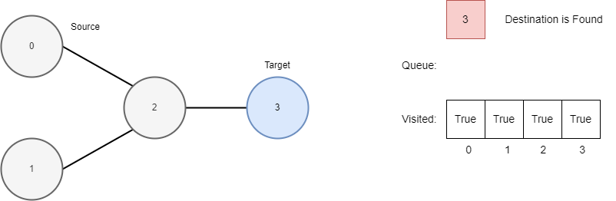
Practice – Challenge #2 - Approach

Slide 17
Practice – Challenge #2 – Solve
Implement the solution for the task.

Slide 18
Practice – Challenge #1
Resource: LeetCode
1971 Find if Path Exists in Graph – Link to the Task.
Solution: BFS (DFS also possible).
Solution – Link.

Slide 19
Hometask
Resource: Competitive Programming 3
Practice:
UVa 00383 – Shipping Routes
UVa 10653 – Knights in FEN
UVa 10389 – Subway
UVa 11624 – Fire

Slide 20




Where to Practice
LeetCode [link]
HackerRank [link]
Kattis [link]
TopCoder [link]
Other Resources

